Slide 1
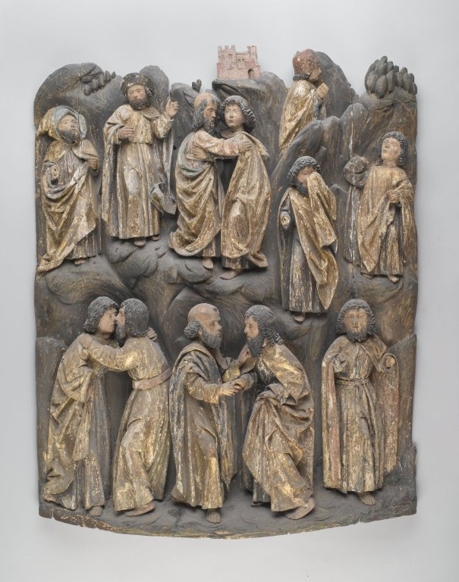
Altar relief from 16th century; BrooklynMuseum.org
John 13.36-14.14

Slide 2
John 13.36 NET: Simon Peter said to him, “Lord, where are you going?” Jesus replied, “Where I am going, you cannot follow me now, but you will follow later.”

Slide 3
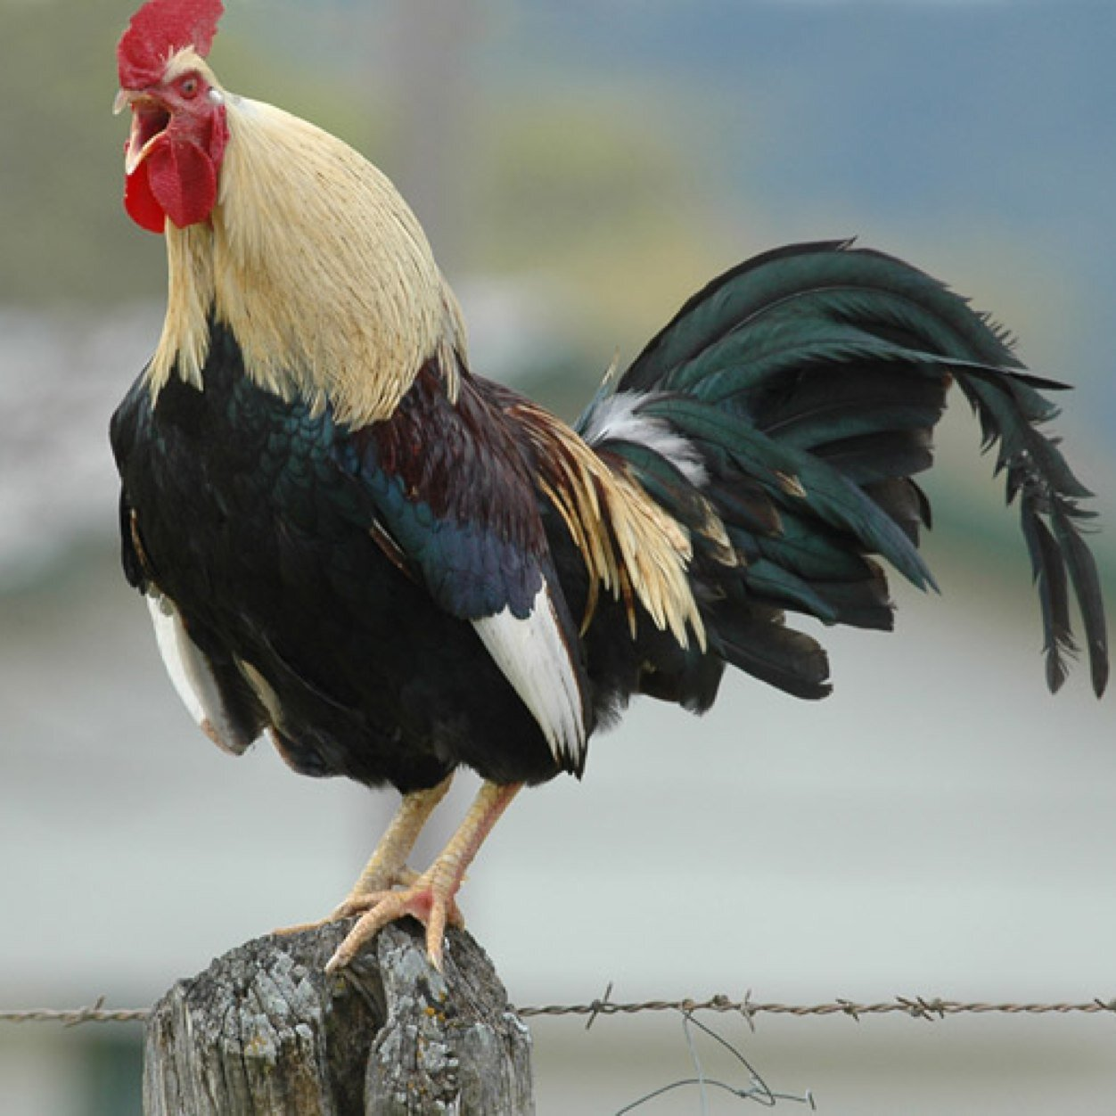
John 13.37-38: Peter said to him, “Lord, why can't I follow you now? I will lay down my life for you!” Jesus answered, “Will you lay down your life for me?
I tell you the solemn
truth, the rooster will
not crow until you have
denied me three times!”

Slide 4
John 13.37-38: Peter said to him, “Lord, why can't I follow you now? I will lay down my life for you!” Jesus answered, “Will you lay down your life for me?
I tell you the solemn
truth, the rooster will
not crow until you have
denied me three times!”
ἀρνέομαι [ar-NEH-uh-my]
deny something is true
disown association
with someone

Slide 5
John 14.1: “Do not let your hearts be distressed. You believe in God; believe also in me.”

Slide 6
John 14.1: “Do not let your hearts be distressed. You believe in God; believe also in me.”
In English: command: You, believe in God.
statement: You believe in God.
In Greek: command: πιστεύετε in God.
statement: πιστεύετε in God.

Slide 7
John 14.1: “Do not let your hearts be distressed. You believe in God; believe also in me.”
Two commands:
You must believe in God; believe also in me.
Two statements:
You believe in God; you believe also in me.
A statement and a command:
You believe in God; believe also in me.
A command and a statement:
You must believe in God; you do believe also in me.

Slide 8
John 14.2-3: “There are many dwelling places in my Father's house. Otherwise, I would have told you, because I am going away to make ready a place for you. And if I go and make ready a place for you, I will come again and take you to be with me, so that where I am you may be too.”
μονή [muh-NAY] = room or place to stay

Slide 9
John 14.2-3: “There are many dwelling places in my Father's house. Otherwise, I would have told you, because I am going away to make ready a place for you. And if I go and make ready a place for you, I will come again and take you to be with me, so that where I am you may be too.”

Slide 10
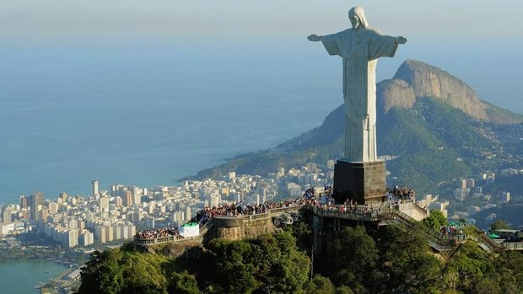
John 14.4-6: “And you know the way where I am going.” Thomas said, “Lord, we don't know where you are going. How can we know the way?”
Jesus replied, “I am the way,
and the truth, and the life.
No one comes to the Father
except through me.”
photo from cbc.ca

Slide 11
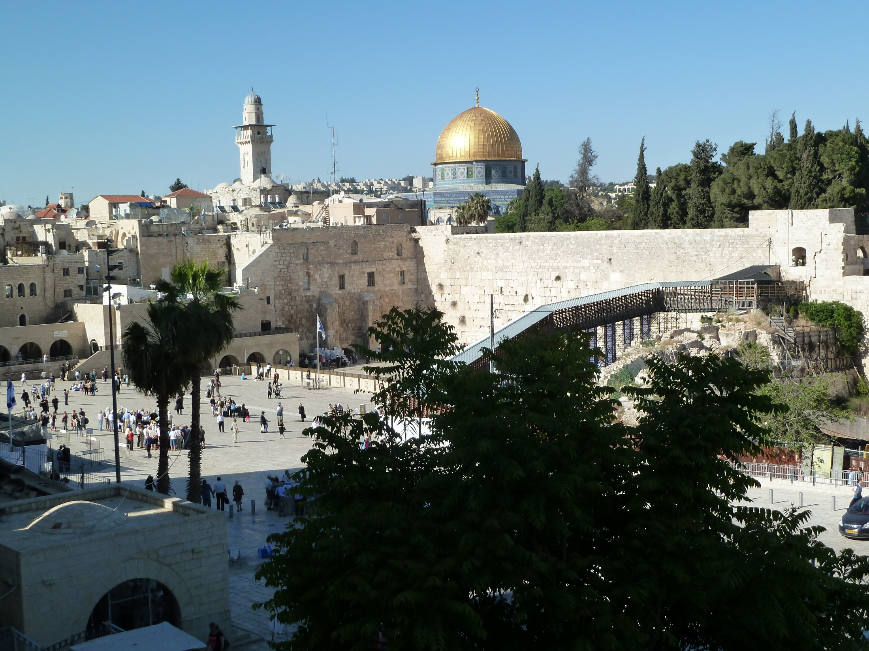
Jesus replied, “I am the way, and the truth, and the life. No one comes to the Father except through me.”

Slide 12
John 14.7-11: “If you have known me, you will know my Father too. And from now on you do know him and have seen him.” Philip said, “Lord, show us the Father, and we will be content.” Jesus replied, “Have I been with you for so long, and you have not known me, Philip? The person who has seen me has seen the Father! How can you say, ‘Show us the Father’? Do you not believe that I am in the Father, and the Father is in me? The words that I say to you, I do not speak on my own initiative, but the Father residing in me performs his miraculous deeds. Believe me that I am in the Father, and the Father is in me, but if you do not believe me, believe because of the miraculous deeds themselves.”

Slide 13
John 14.12-14: “I tell you the solemn truth, the person who believes in me will perform the miraculous deeds that I am doing, and will perform greater deeds than these, because I am going to the Father. And I will do whatever you ask in my name, so that the Father may be glorified in the Son. If you ask me anything in my name, I will do it.”

Slide 14
John 14.12-14: “I tell you the solemn truth, the person who believes in me will perform the miraculous deeds that I am doing, and will perform greater deeds than these, because I am going to the Father. And I will do whatever you ask in my name, so that the Father may be glorified in the Son. If you ask me anything in my name, I will do it.”

Slide 15
Reflect on scriptural truth...
learn about God, grace, provision and assurance
remain strong in faith
be encouraged and comforted
come to know and experience Jesus
come to know God the Father
grow spiritually
become equipped to teach truth
be ready to pursue the gospel mission
learn to discern God’s will, yield to Holy Spirit
learn to live and pray in Jesus’ name
have God work through you mightily

